Slide 1

Configuration Management

Slide 2

Group - 8
Khine Khine Kyaw (Presenter)
Kay Thi Oo
Thida Tun
Thandar Soe

Slide 3

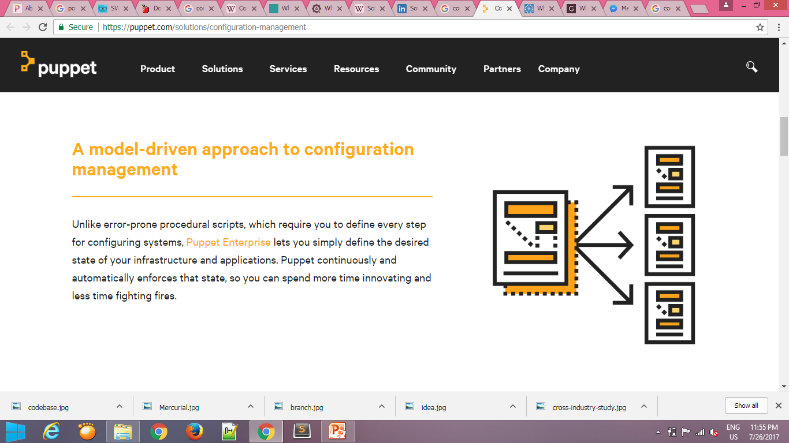
Configuration Management (CM)
The set of activities that have been developed to manage change throughout the software life cycle.

Slide 4

Why should use CM tools?
To store information about versions and builds of the software
Traceability between software and different versions or variants
To build and release management
Access control (checking in and out)
Make a lot easier in complex environments

Slide 5





Slide 6
Mercurial
Distributed version control
Command-line driven program
Several IDEs support such as Mozilla, OpenJDK, Python, NetBeans
Free software license under the terms of the GNU General Public License Version 2
The hg command provides a command line interface to the Mercurial system

Slide 7
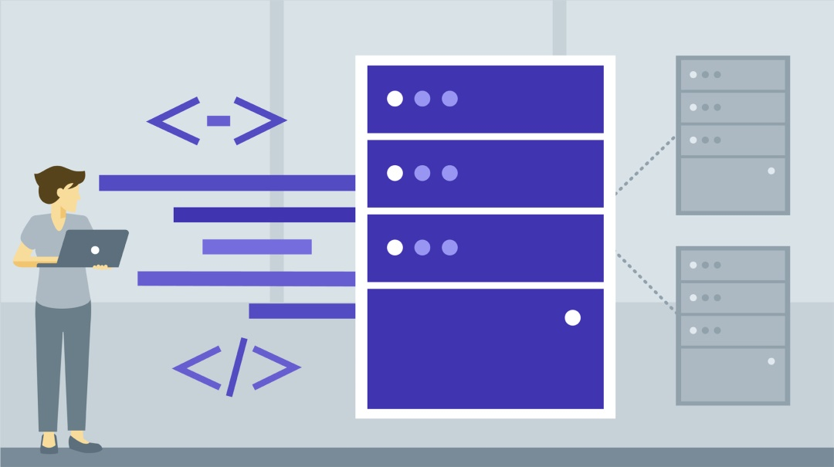
Benefits of mercurial
Fast and powerful
Easy to learn
Can work and commit the changes to your local repository without internet connection

Slide 8
Codebase
A whole collection of source code
A source code repository is a place where large amounts of source code are kept, either publicly or privately
It includes only human-written source code files, but it does not include generated files or object files

Slide 9
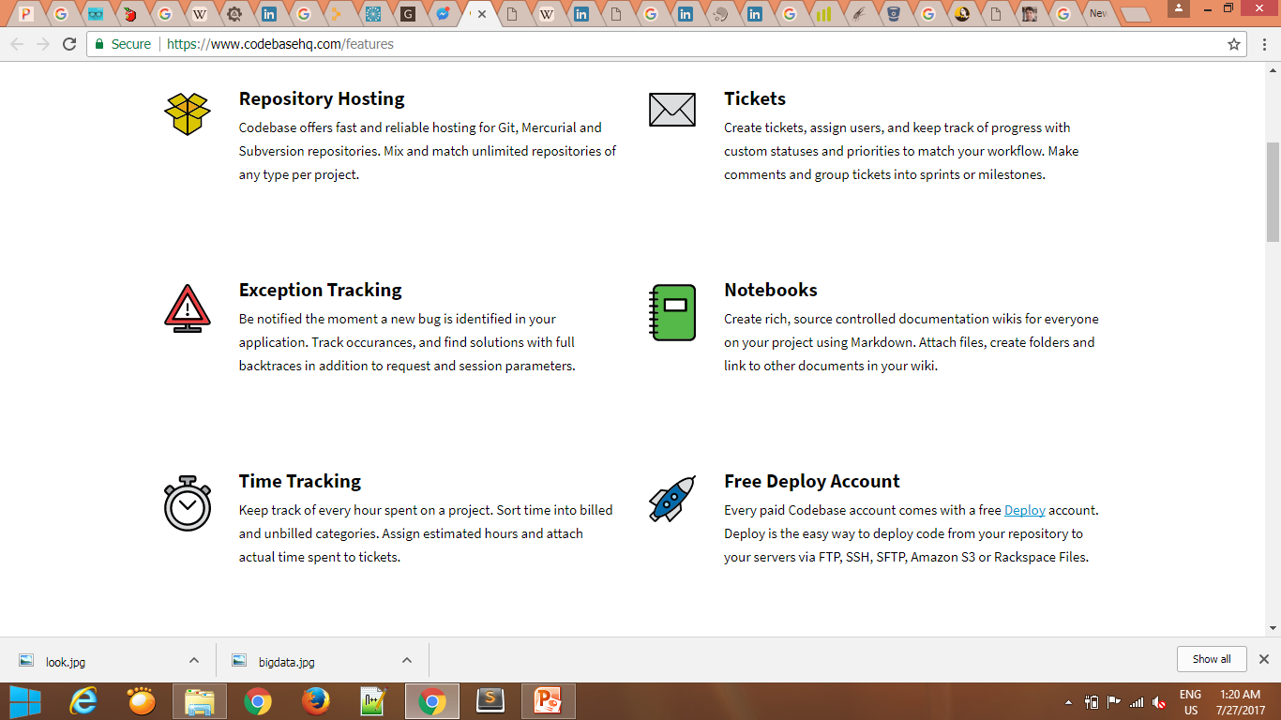

Codebase Main Features
Repository Hosting
Exception Tracking
Time Tracking
View Commits & Compare Diffs

Slide 10
Installation
Download Python from http://www.python.org/download/.
Download Mercurial source from http://www.selenic.com/mercurial/release/?M=D.
Download the MinGW binary from http://sourceforge.net/project/showfiles.php?group_id=2435&package_id=240780
Download KDiff3 from http://sourceforge.net/project/showfiles.php?group_id=58666.

Slide 11
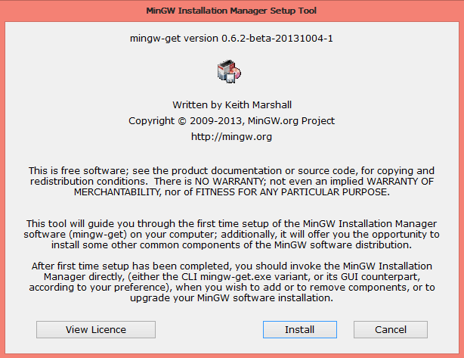
MinGW

Slide 12
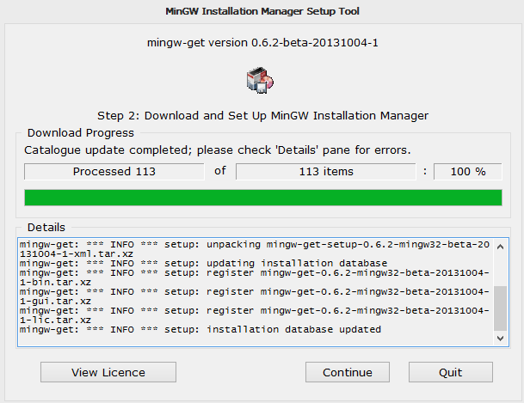

Slide 13
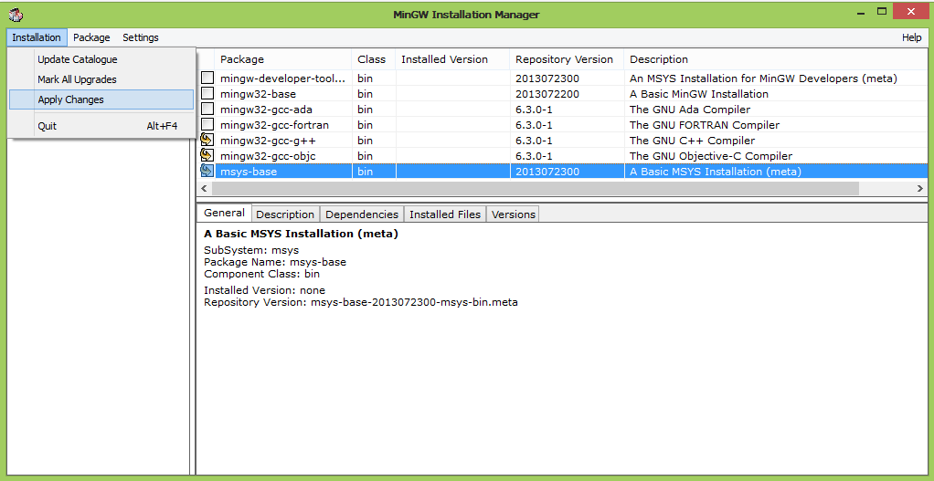

Slide 14
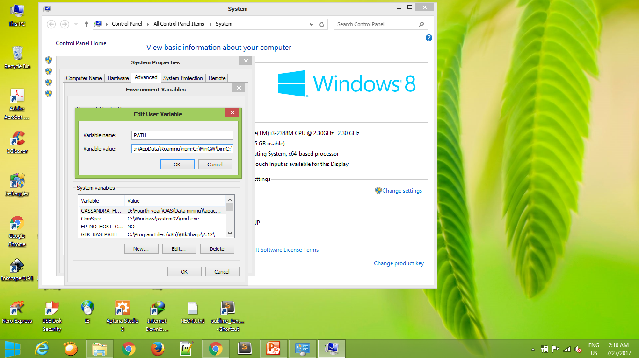

Slide 15
In Windows command prompt, change dir to C:\Mercurial_src
python setup.py build --force -c mingw32
python setup.py install --force --skip-build
C:\Python26\python.exe setup.py --pure build_py -c -d . build_ext -i build_mo --force
C:\Python26\python.exe setup.py --pure install --force

Slide 16
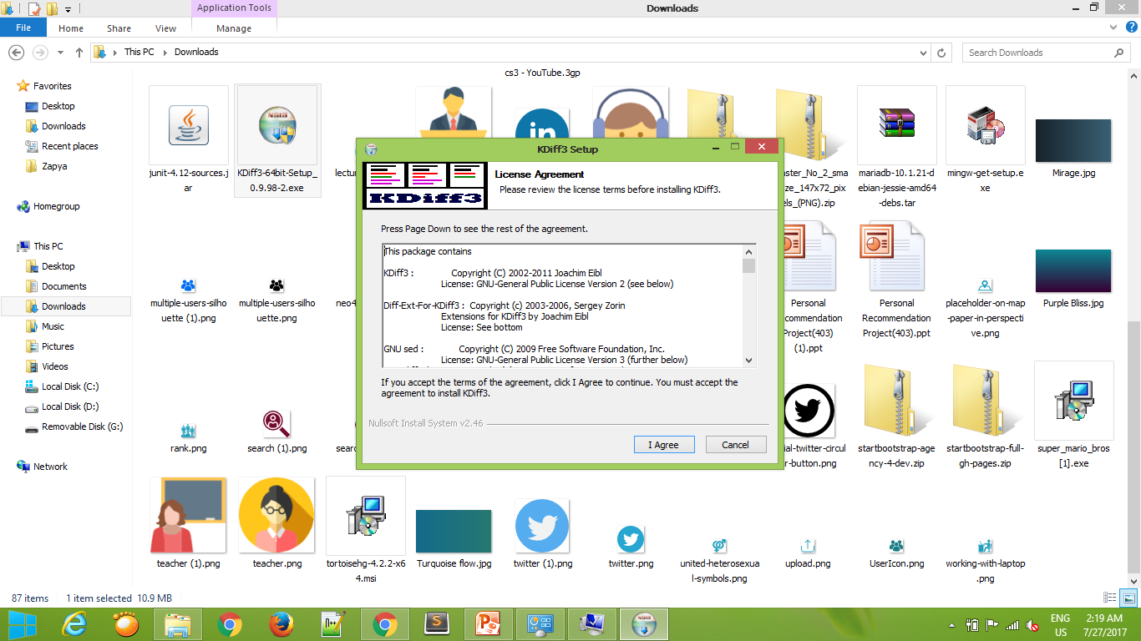
KDiff3

Slide 17
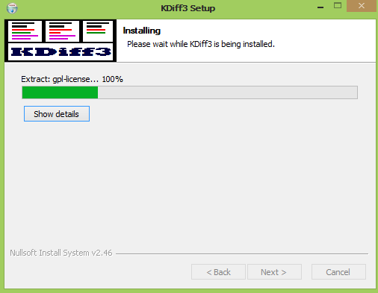

Slide 18
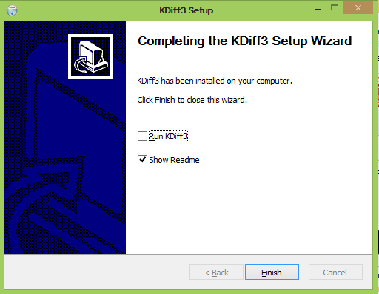

Slide 19
Practical Time

